Slide 1
Microsoft 365
Working with Documents

Slide 2
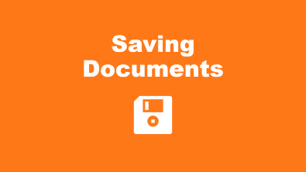
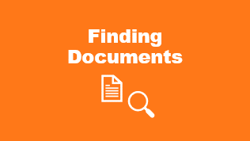

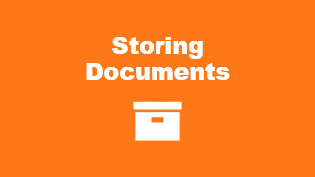
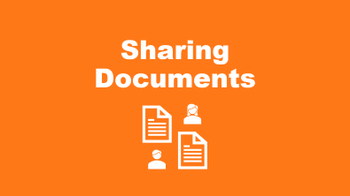

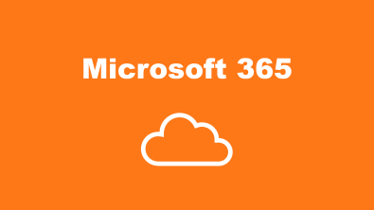
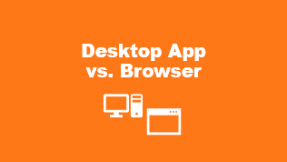


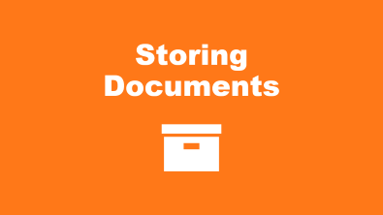
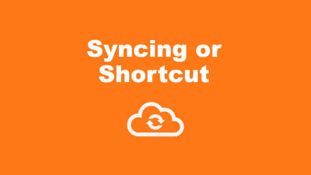
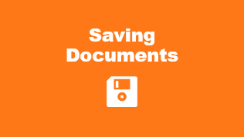
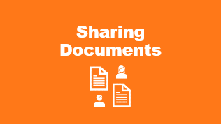
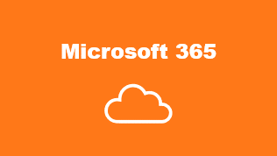
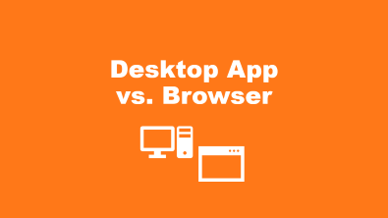


Slide 3

Microsoft 365

Slide 4

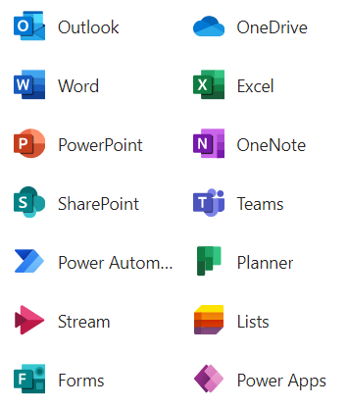
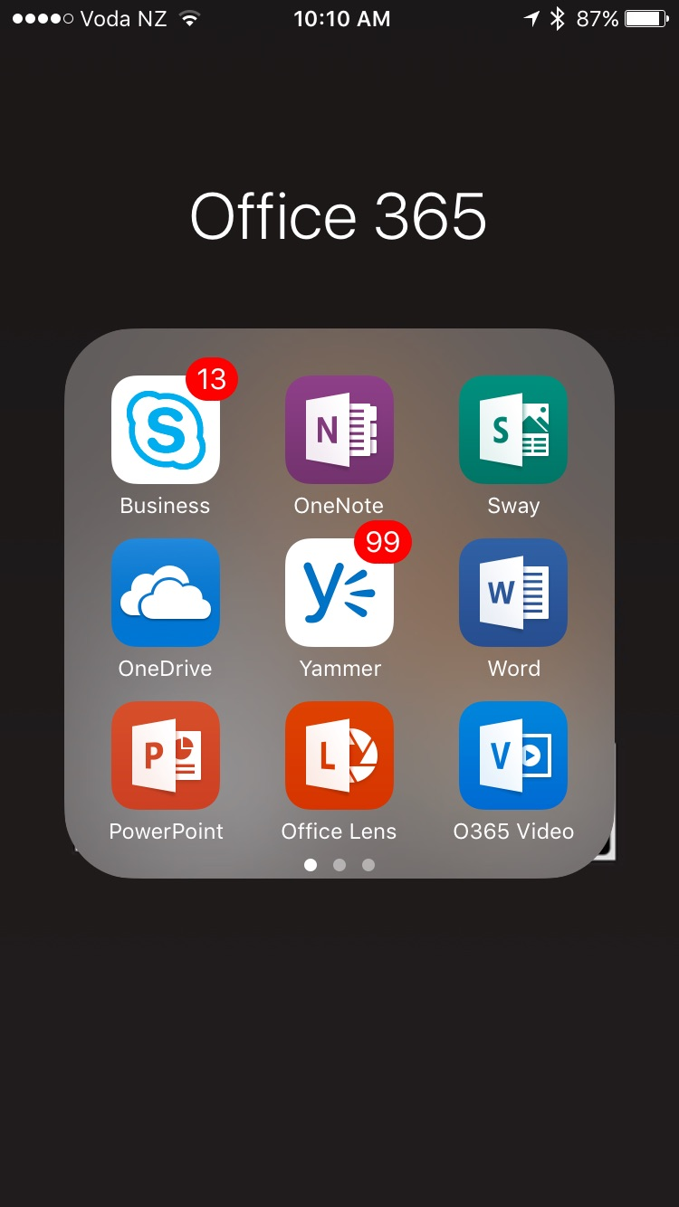
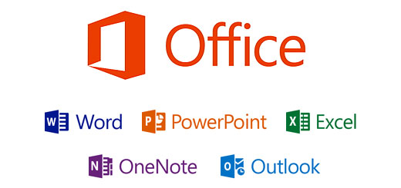

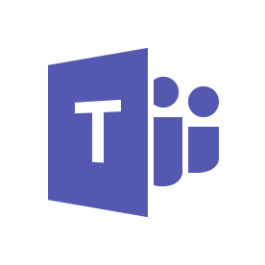
What is Microsoft 365?
Desktop | Storage and Communication | Online Apps | Mobile Apps
OneDrive
SharePoint
Teams

Slide 5

Storing
Documents

Slide 6

OneDrive vs.
SharePoint
and Teams
Anywhere access for all your files
Our files
Content collaboration for teams and organizations
My files
Our files

Slide 7
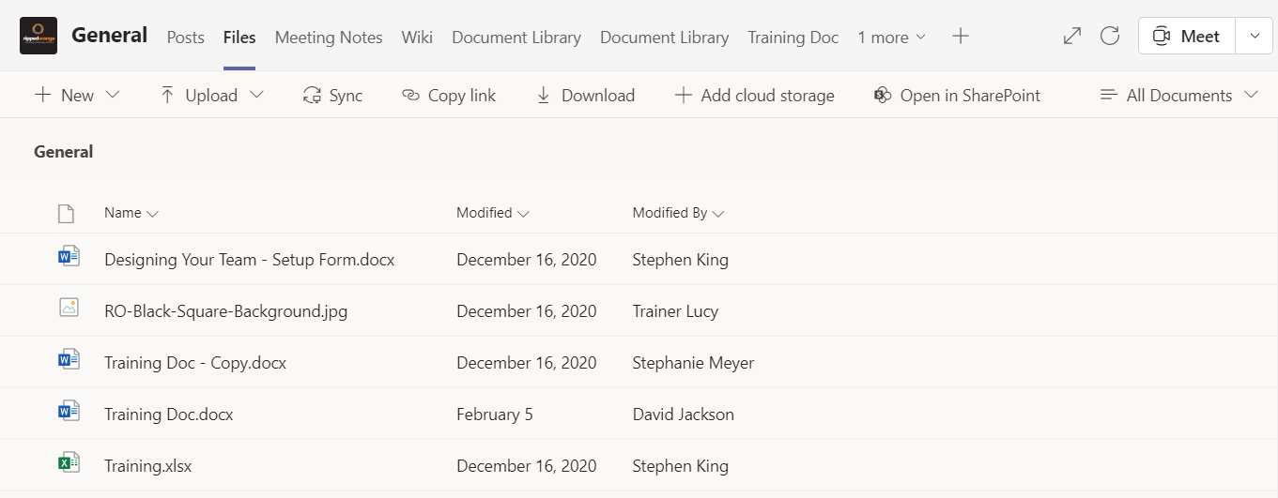
Teams

Slide 8










WORD ONLINE
MOBILE WORD
FILE EXPLORER
DESKTOP WORD

Slide 9

Saving Documents

Slide 10
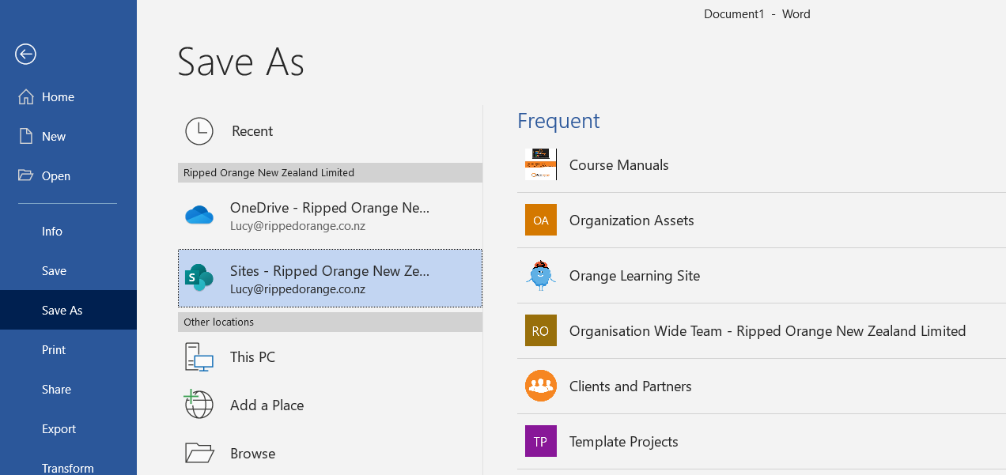
Saving Files

Slide 11
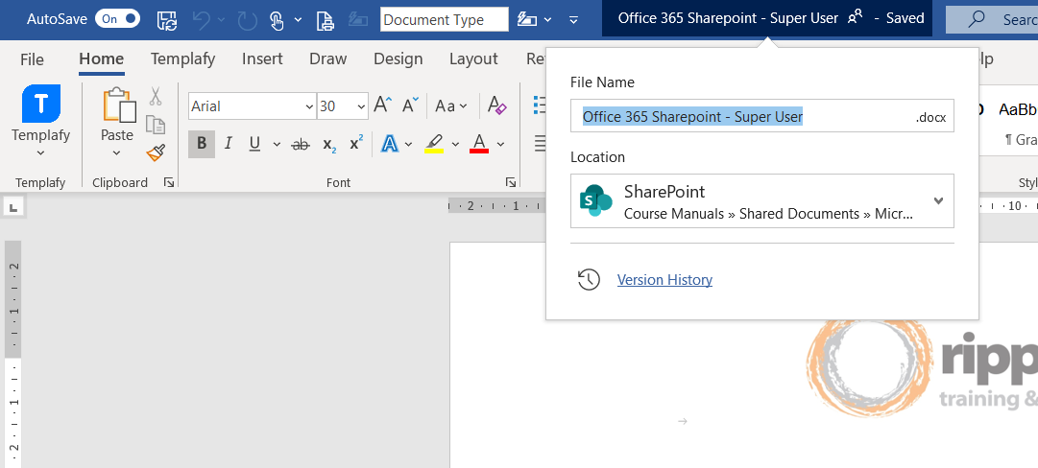
AutoSave

Slide 12


Finding Documents

Slide 13
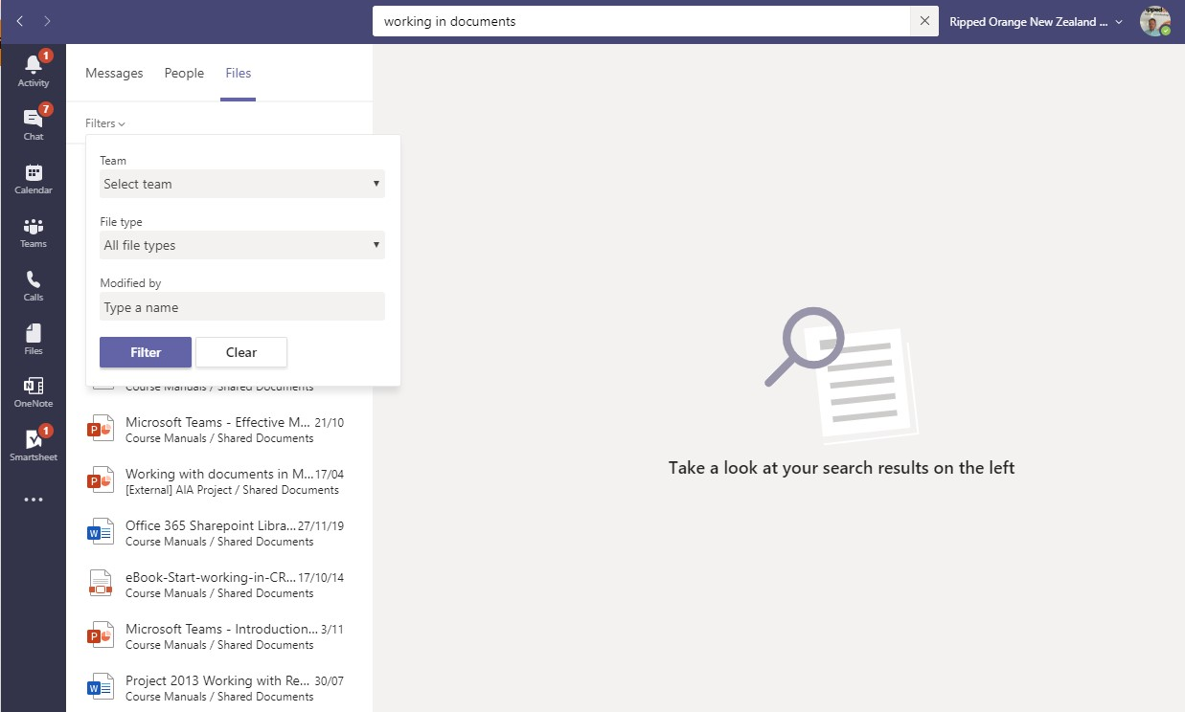

Finding Files in Teams
Searching
  Searches title
  and content

Slide 14
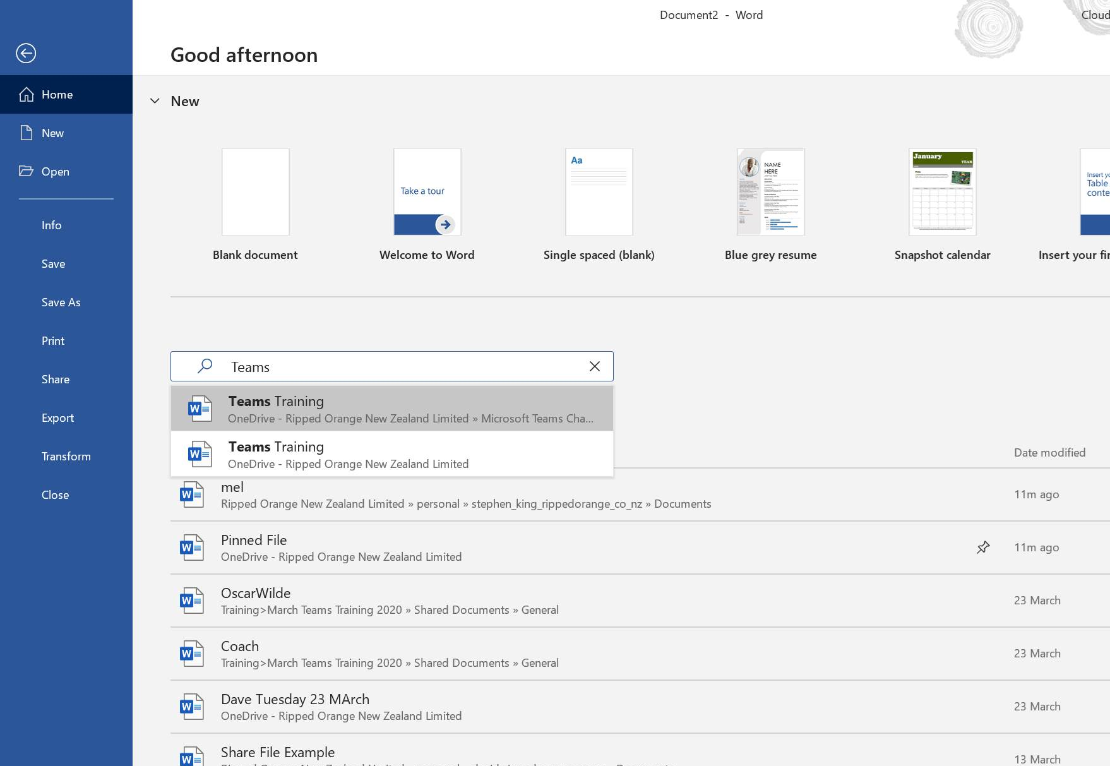

Finding Files in Office
Pinning and
Searching
  Collaborating
  on documents

Slide 15


Desktop App vs. Browser

Slide 16
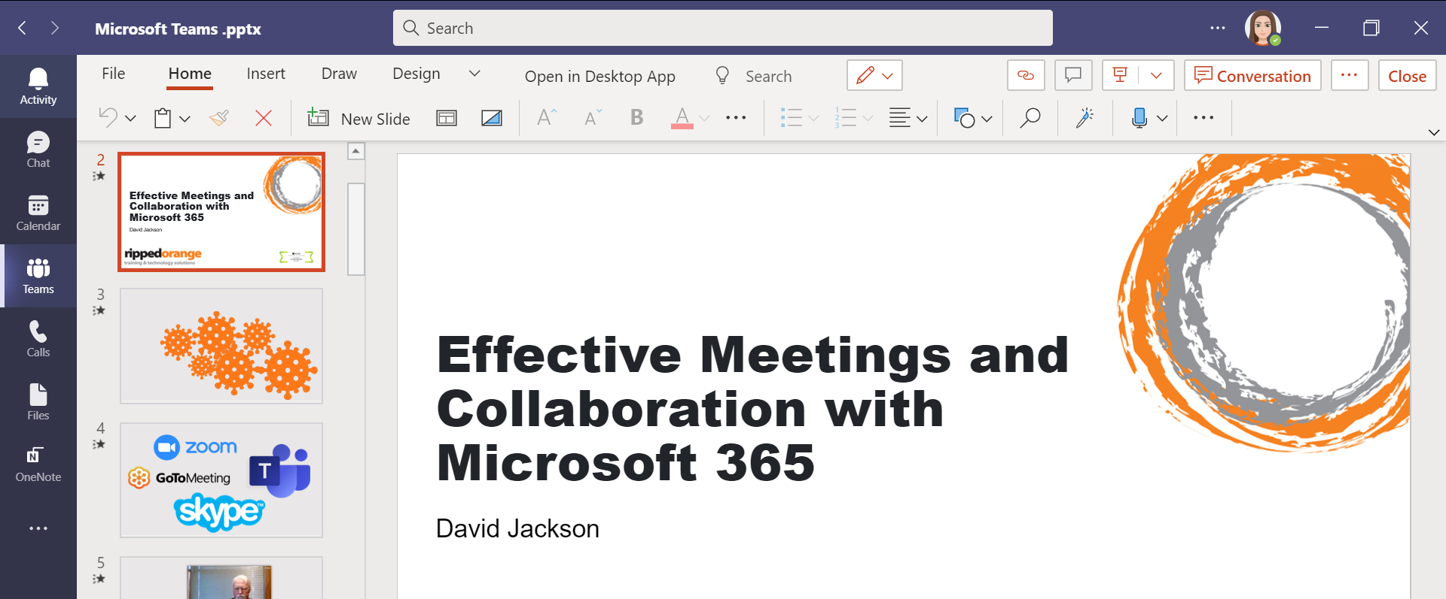
Working on Files in Teams

Slide 17
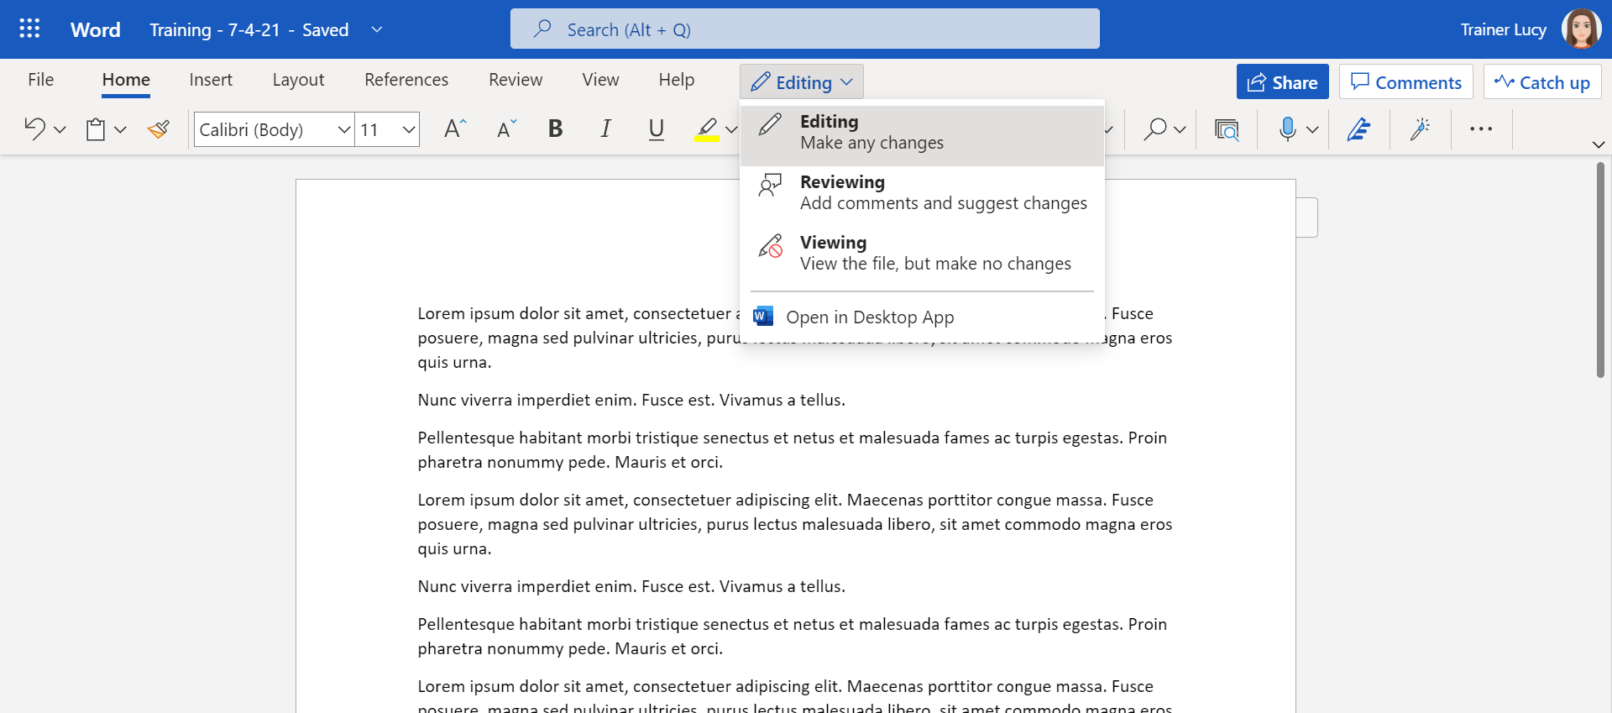
Working in the Browser
Notes:
Simplified ribbon
Editing and Reviewing modes
Open in Desktop App

Slide 18


Sharing
Documents

Slide 19


Why share a link?
One source of truth
Always the most up to date version
Less email traffic
Security permissions

Slide 20
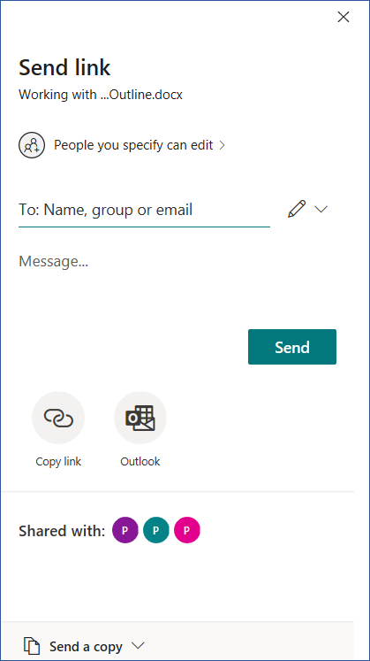
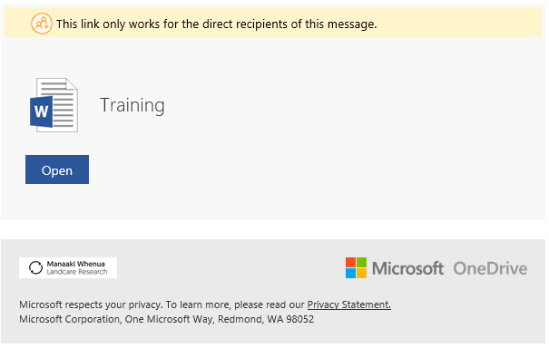
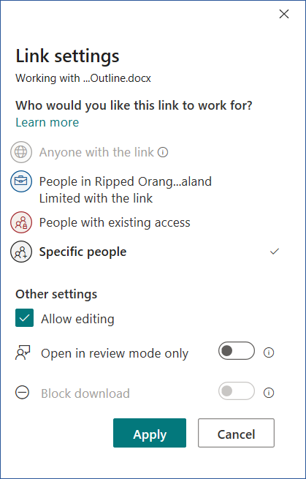
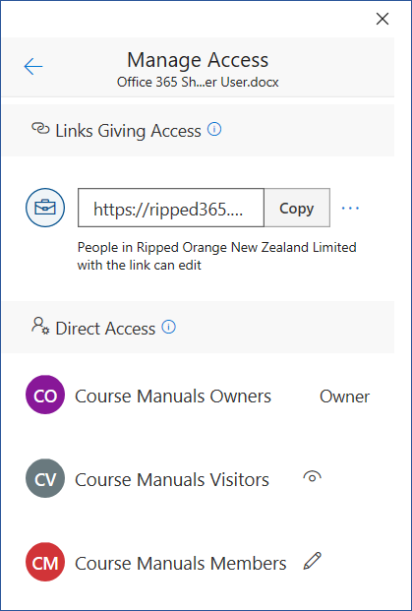
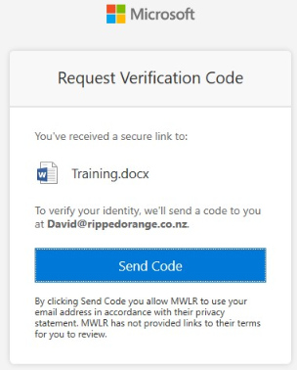
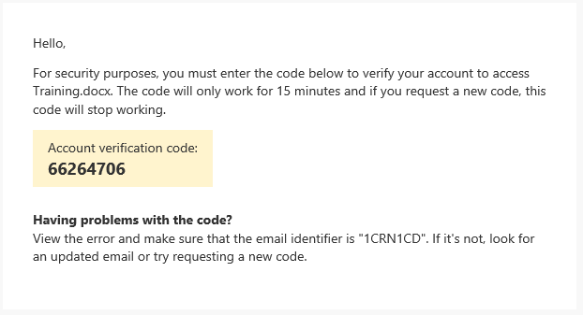
Sharing Files

Slide 21
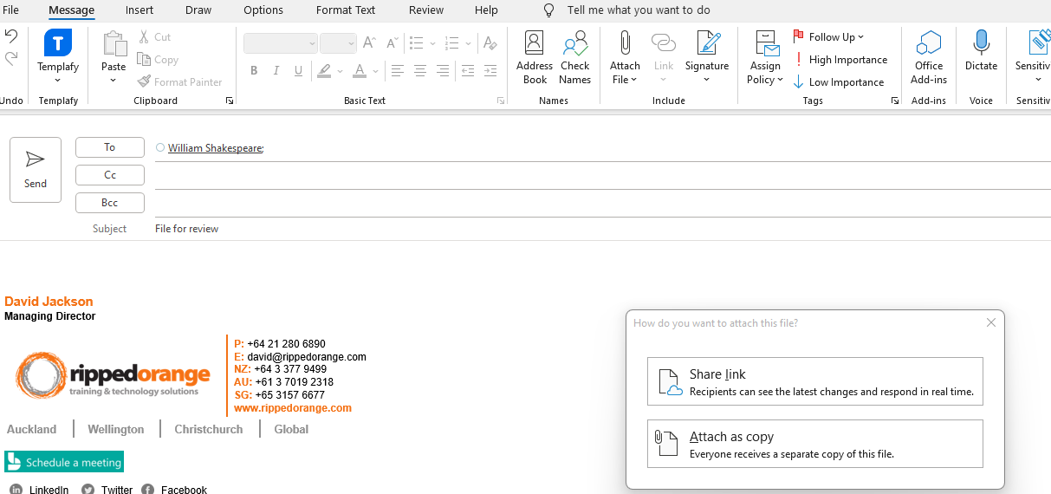
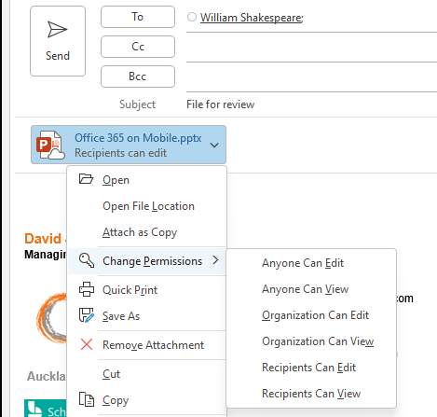
Sharing / Attaching files in Outlook

Slide 22

Co-Authoring

Slide 23
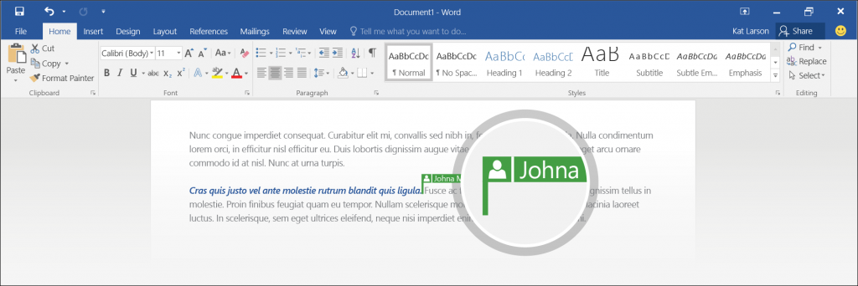
Co-Authoring an Office Doc
Edit a document in real time with other people
Work in the browser or the full application (i.e. Word)
See who is editing and where in the document they are

Slide 24
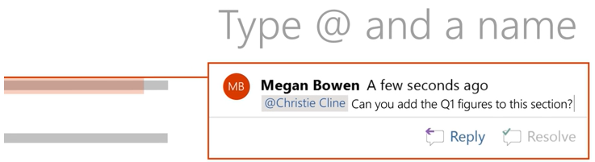
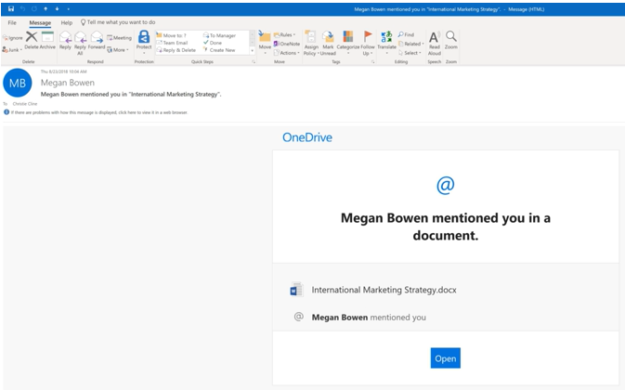
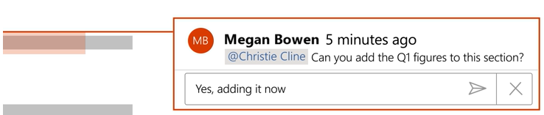
@mention in comments
Use the @ symbol to mention someone in a comment
The person receives an email with a link to the comment
Reply to a comment

Slide 25
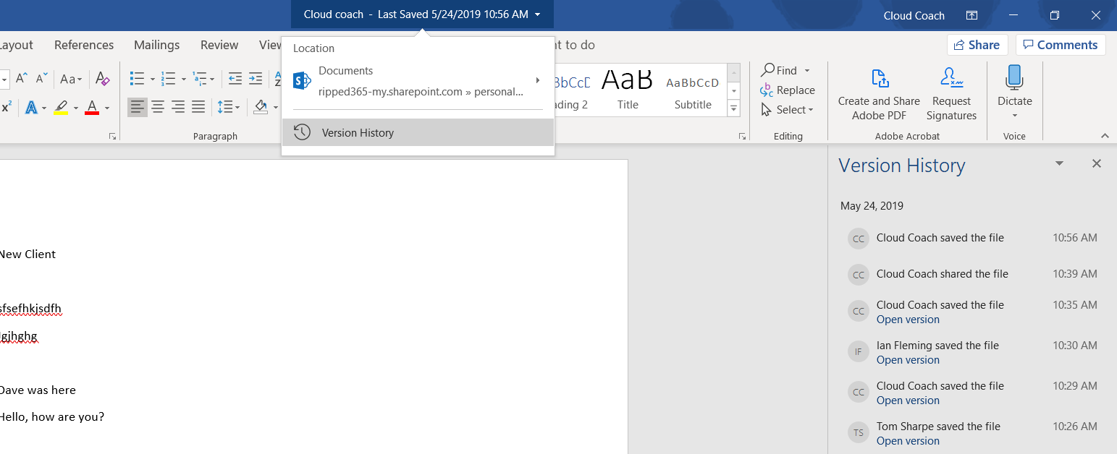
Version History
Notes:
Access version history from inside a document
Restore to older versions if necessary

Slide 26

Syncing or
Shortcut

Slide 27
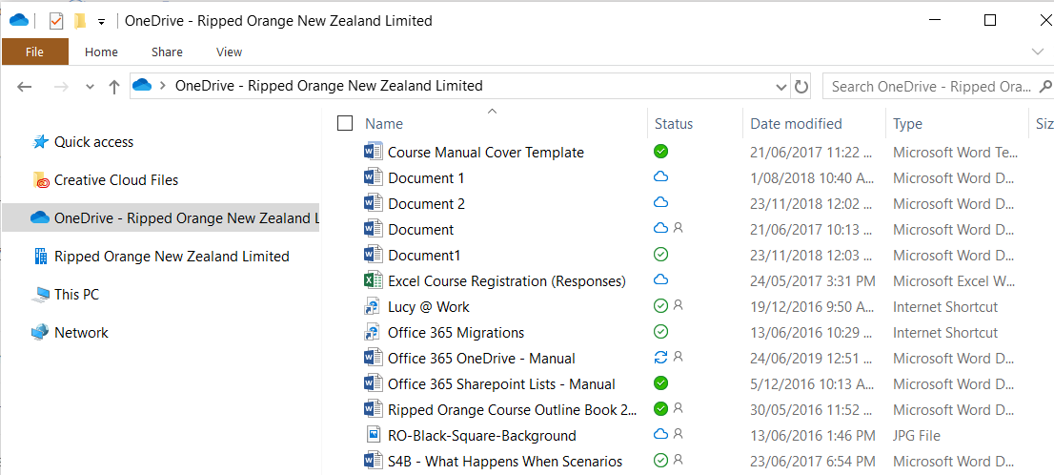




Files on Demand
Syncing
Locally available
Always available
Online only
Shared
Notes:
A blue cloud icon next to a OneDrive file or folder indicates that the file is only available online. Online-only files don’t take up space on your computer. You see a cloud icon for each online-only file in File Explorer, but the file doesn’t download to your device until you open it. You can’t open online-only files when your device isn’t connected to the Internet.
When you open an online-only file, it downloads to your device and becomes a locally available file. You can open a locally available file anytime, even without Internet access. If you need more space, you can change the file back to online only. Just right-click the file and select “Free up space.”
With Storage Sense turned on, these files will become online-only files after the time period you've selected.
Only files that you mark as "Always keep on this device" have the green circle with the white check mark. These always available files download to your device and take up space, but they’re always there for you even when you’re offline.

Slide 28
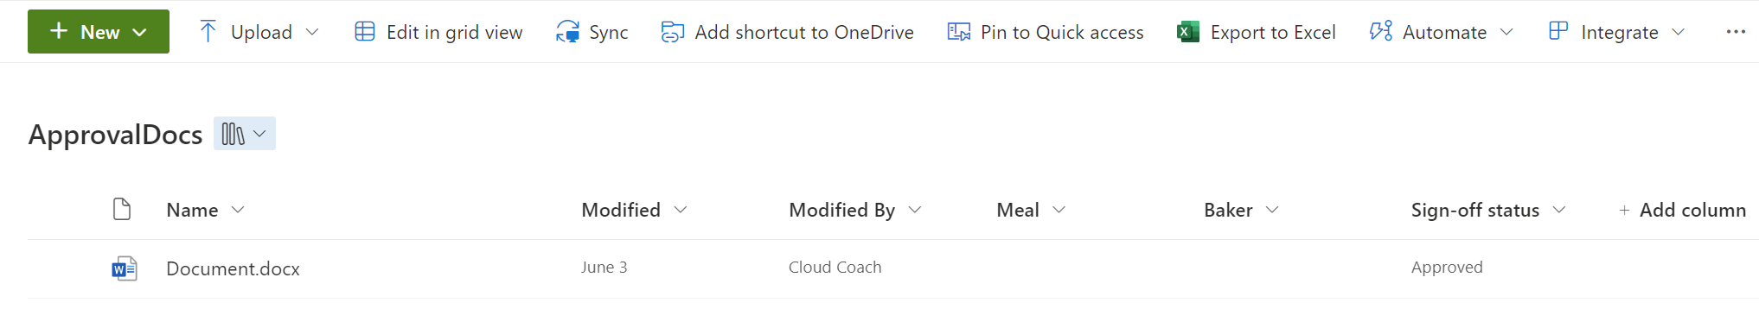
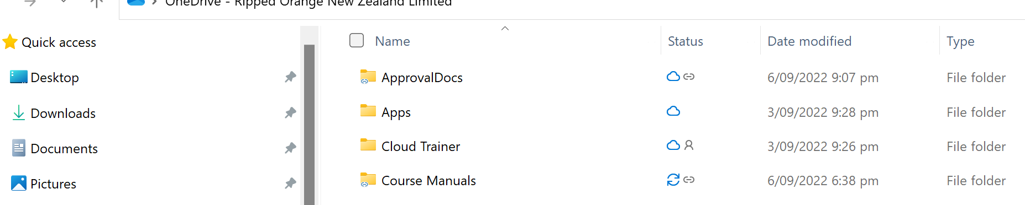
Shortcut Documents

Slide 29
Shortcut vs Sync
Shortcut
Can delete shortcut and files are not deleted
Shortcuts are in your OneDrive and on all devices
Only shortcut the folders you need
Can’t shortcut a folder already synced or in a shortcut
Sync
Delete folder and files are deleted
Shows files under different icon
Sync a whole library

Slide 30
Questions?
External Sharing
Deleted Files

